Slide 1
Our Mission: Creating caring, supportive communities for individuals living with mental health difficulties and their families.
Our Vision: Transformation of the Traditional Approach and Treatment of Mental Illness.

Slide 2
Mental Health & the Chaplain

Slide 3
Matt. 4:16 “the people living in darkness have seen a great light; on those living in the land of the shadow of death, a light has dawned!”

Slide 4
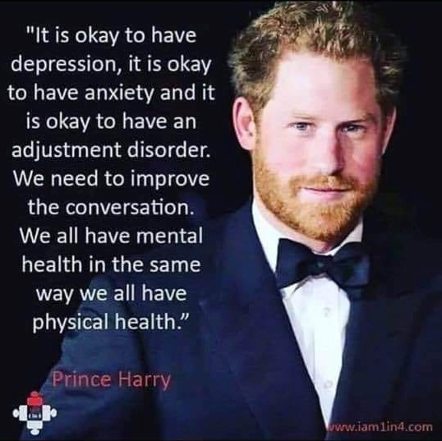
we ALL have a mental health

Slide 5
Mayo Clinic –
Mental illness refers to a wide range of mental health conditions — disorders that affect your mood, thinking and behavior. Examples of mental illness include depression, anxiety disorders, schizophrenia, eating disorders and addictive behaviors…..

Slide 6
Many people have mental health concerns from time to time. But a mental health concern becomes a mental illness when ongoing signs and symptoms cause frequent stress and affect your ability to function.
(Mayo Clinic)

Slide 7
“Neuropsychiatric disorders are among the most disabling of ALL illnesses including physical illnesses.”
World Health Organization (WHO)

Slide 13
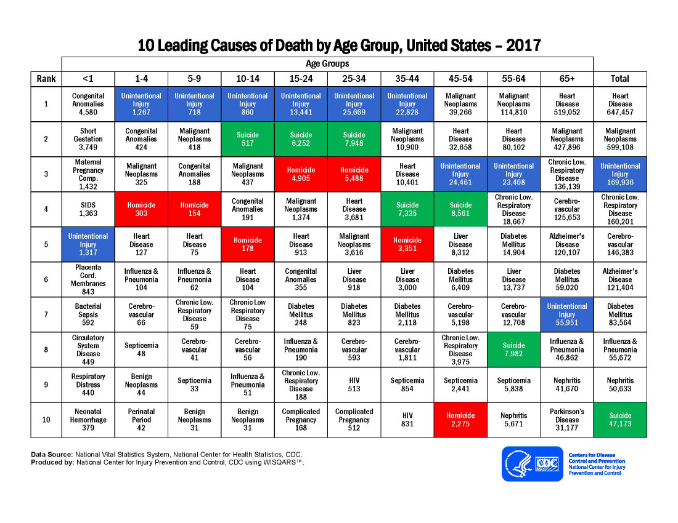

Slide 14
In 2017 there were 47,173 reported suicide deaths in the US
and an estimated 1,400,000 suicide attempts

Slide 23
5 Action Steps for Chaplains MH:
Prayer! Establish a prayer team!
2. Exercise
3. Rest/Nourishment
4. Quiet Times w/God
5. Reach out for support!

Slide 24
2. Exercise!
“Fresh air, open spaces, a stiff walk in the wind, will not yield grace to the soul, but it will yield oxygen to the body which is next best.”
- Charles Spurgeon

Slide 25
3. Rest/Nourishment
The Anxiety and Depression Association of America encourages those suffering from depression, both circumstantial and clinical, to get additional sleep and to eat well-balanced meals, both of which enable the body to persist through the taxing symptoms of depression.

Slide 26
4. Quiet Times with God
“…and after the fire came a gentle whisper. When Elijah heard it, he pulled his cloak over his face and went out and stood at the mouth of the cave. Than a voice said to him, “What are you doing Elijah?”
I Kings 19:12-13 (NIV)

Slide 27
Take a break!
personal day off, vacation, …
Tune out the noise!
Reduce interaction with sources that increase anxiety/depression (social media)

Slide 28
5. Reach out for support!
Healing starts with vulnerability!
He (Elijah) replied,“.....I am the only one left and now they are trying to kill me.”
I Kings 19:14

Slide 29
“People with stronger connections to their families and communities, including communities of faith, are less vulnerable to mental health problems such as depression and anxiety.”
Mental Health Foundation

Slide 30
Mental Health First Aid is the help offered to a person developing a mental health problem or experiencing a mental health crisis. The first aid is given until appropriate treatment and support are received or until the crisis resolves.
WHAT IS MENTAL HEALTH FIRST AID?

Slide 31
Program Overview
What is Mental Health First Aid (MHFA)?
Mental Health Problems in the United States
Mental Health First Aid Action Plan
Understanding Depression and Anxiety
Mental Health First Aid Action Plan for Depression and Anxiety
Suicidal Thoughts and Behavior
Symptoms of Depression
Non-suicidal Self-Injury
SESSION 1

Slide 32
Mental Health First Aid Action Plan for Depression and Anxiety
Panic Attacks
Traumatic Events
Symptoms of Anxiety
Understanding Psychosis
Mental Health First Aid Action Plan
Psychosis
Disruptive or Aggressive Behavior
Understanding Substance Use Disorders
Mental Health First Aid Action Plan
Overdose
Withdrawal
Substance Use Disorders
Using your Mental Health First Aid Training
SESSION 2

Slide 33
Mental health problems are common
Stigma is associated with mental health problems
Many people are not well informed
Professional help is not always on hand
People often do not know how to respond
People with mental health problems often do not seek help
WHY MENTAL HEALTH FIRST AID?

Slide 34
A mental disorder or mental illness is a diagnosable illness that:
Affects a person’s thinking, emotional state, and behavior
Disrupts the person’s ability to:
Work
Carry out daily activities
Engage in satisfying relationships
WHAT IS A MENTAL DISORDER?

Slide 35
U.S. Adults with a Mental Disorder
in Any One Year
Type of Mental Disorder | % Adults
Anxiety disorder | 18.1 .
Major depressive disorder | 6.8 .
Substance use disorder | 8.1
Bipolar disorder | 2.8 .
Eating disorders | 5-10 .
Schizophrenia | 0.3 – 0.7 .
Any mental disorder | 18.5 .
ADULTS WITH A MENTAL DISORDER
Only 41% of people with a mental illness use mental health services in any given year
3

Slide 36
The Impact of Mental Illness
“Disability” refers to the amount of disruption a health problem causes to a person’s ability to:
Work
Carry out daily activities
Engage in satisfying relationships
Mental illnesses can be more disabling than many chronic physical illnesses. For example:
The disability from moderate depression is similar to the impact from relapsing multiple sclerosis, severe asthma, or chronic hepatitis B.
The disability from severe depression is comparable to the disability from quadriplegia.
IMPACT

Slide 37
Recovery from Mental Illness
“Recovery is the process in which people are able to live, work, learn, and participate fully in their communities.”
“For some, this is the ability to live a fulfilling and productive life despite a disability.”
“For others, recovery implies the reduction or complete remission of symptoms.”
— President’s New Freedom Commission on Mental Health
RECOVERY

Slide 38
Mental Health First Aid: The Action Plan
Assess for risk of suicide or harm
Listen nonjudgmentally
Give reassurance and information
Encourage appropriate professional help
Encourage self-help and other support strategies
THE ACTION PLAN

Slide 39
Depression & Anxiety…
DEPRESSION & ANXIETY
Are the most common mental illnesses
Have some similar signs and symptoms
Frequently co-occur

Slide 40
Depression
Major depressive disorder lasts for at least 2 weeks and affects a person’s
Emotions, thinking, behavior, and physical well-being
Ability to work and have satisfying relationships
Ability to carry out usual daily activities
DEPRESSION

Slide 41
Major depressive disorder
Bipolar disorder
Postpartum depression
Seasonal depression
TYPES OF MOOD DISORDERS

Slide 42
Depression: Signs and Symptoms
Physical
Fatigue
Lack of energy
Sleeping too much or too little
Overeating or loss of appetite
Constipation
Weight loss or gain
Headaches
Irregular menstrual cycle
Loss of sexual desire
Unexplained aches and pains
Behavioral
Crying spells
Withdrawal from others
Neglect of responsibilities
Loss of interest in personal appearance
Loss of motivation
Slow movement
Use of drugs and alcohol
DEPRESSION

Slide 43
Depression: Signs and Symptoms
Psychological
Sadness
Anxiety
Guilt
Anger
Mood swings
Lack of emotional responsiveness
Feelings of helplessness
Hopelessness
Irritability
Frequent self-criticism
Self-blame
Pessimism
Impaired memory and concentration
Indecisiveness and confusion
Tendency to believe others see one in a negative light
Thoughts of death and suicide
DEPRESSION

Slide 44
Anxiety
Anxiety disorder differs from normal stress and anxiety
The symptoms of an anxiety disorder are more severe and can cause impairment in daily life (i.e.. Work, relationships)
ANXIETY

Slide 45
Anxiety: Signs and Symptoms
Physical
Cardiovascular: pounding heart, chest pain, rapid heartbeat, blushing
Respiratory: fast breathing, shortness of breath
Neurological: dizziness, headache, sweating, tingling, numbness
Gastrointestinal: choking, dry mouth, stomach pains, nausea, vomiting, diarrhea
Musculoskeletal: muscle aches and pains (especially neck, shoulders and back), restlessness, tremors and shaking, inability to relax
ANXIETY

Slide 46
Anxiety: Signs and Symptoms
Behavioral
Avoidance of situations, obsessive or compulsive behavior, distress in social situations, phobic behavior
Psychological
Unrealistic or excessive fear and worry (about past and future events), mind racing or going blank, decreased concentration and memory, indecisiveness, irritability, impatience, anger, confusion, restlessness or feeling “on edge” or nervous, fatigue, sleep disturbance, vivid dreams
ANXIETY

Slide 47
Risk Factors for Depression & Anxiety
Distressing and uncontrollable event
Stressful or traumatic events
Difficult childhood; history of childhood anxiety
Ongoing stress and anxiety
Another mental illness
Previous episode of depression or anxiety
Family history
More sensitive emotional nature
DEPRESSION & ANXIETY

Slide 48
Risk Factors for Depression & Anxiety
Illness that is life threatening, chronic or associated with pain
Medical conditions
Side effects of medication
Recent childbirth
Premenstrual changes in hormone levels
Lack of exposure to bright light in winter
Chemical (neurotransmitter) imbalance
Substance misuse; intoxication, withdrawal
DEPRESSION & ANXIETY

Slide 49
Mental Health First Aid: The Action Plan
Assess for risk of suicide or harm
Listen nonjudgmentally
Give reassurance and information
Encourage appropriate professional help
Encourage self-help and other support strategies
THE ACTION PLAN

Slide 50
Assess for Risk of Suicide or Harm
The most common crises to assess for
with depressive and anxiety symptoms are:
Suicidal thoughts and behaviors
Non-suicidal self-injury
THE ACTION PLAN: “A”

Slide 51
Suicide Risk Assessment
Gender
Age
Chronic physical illness
Mental illness
Use of alcohol or other substances
Less social support
Previous attempt
Organized plan
THE ACTION PLAN: “A”

Slide 52
Warning Signs of Suicide
Threatening to hurt or kill oneself
Seeking access to means
Talking, writing, or posting on social media about death, dying, or suicide
Feeling hopeless
Feeling worthless or a lack of purpose
Acting recklessly or engaging in risky activities
Feeling trapped
Increasing alcohol or drug use
Withdrawing from family, friends, or society
Demonstrating rage and anger or seeking revenge
Appearing agitated
Having a dramatic change in mood
THE ACTION PLAN: “A”

Slide 53
Questions to Ask
Ask directly whether the person is suicidal:
“Are you having thoughts of suicide?”
“Are you thinking about killing yourself?”
If “yes “ to either above, then…
Ask whether the person has a plan:
“Have you decided how you are going to kill yourself?”
“Have you decided when you would do it?”
“Have you collected the things you need to carry out your plan?”
THE ACTION PLAN: “A”

Slide 54
How to Talk with a Person Who Is Suicidal
Let the person know you are concerned and willing to help
Discuss your observations with the person
Ask the question(s) without dread
Do not express a negative judgment
Appear confident, as this can be reassuring
Check For Two Other Risks:
Has the person been using alcohol or other drugs?
Has he or she made a suicide attempt in the past?
THE ACTION PLAN: “A”

Slide 55
Keeping the Person Safe
Provide a safety contact number
Help the person identify past supports
Involve them in decision making
Call law enforcement immediately if the person has a weapon or is behaving aggressively
Do Not
Leave an actively suicidal person alone
Use guilt and threats to try to prevent suicide
“You will go to hell”
“You will ruin other people’s lives if you die by suicide”
Agree to keep their plan a secret
THE ACTION PLAN: “A”

Slide 56
Mental Health First Aid: The Action Plan
Assess for risk of suicide or harm
Listen nonjudgmentally
Give reassurance and information
Encourage appropriate professional help
Encourage self-help and other support strategies
THE ACTION PLAN

Slide 57
SESSION 2
Mental Health First Aid Action Plan for Depression and Anxiety
Panic Attacks
Traumatic Events
Anxiety Symptoms
Understanding Psychosis
Mental Health First Aid Action Plan
Acute Psychosis
Disruptive or Aggressive Behavior
Understanding Substance Use Disorders
Mental Health First Aid Action Plan
Overdose
Withdrawal
Substance Use Disorders
Using your Mental Health First Aid Training
SESSION 2

Slide 58
Mental Health USA Offers:
Mental Health First Aid Training
Public Safety Officials/Law Enforcement
Fire/EMS
Adults 18+
Veterans
Higher Education
Youth
Crisis Response Training
Biblical Support Group Leader Training
Internships
Discipleship Training School - coming soon! (www.restorationmin.com)
To request a training in your area contact:
Chaplain Valerie Saviano @
Email: valeries@MentalHealthUSA.org
Website: www.MentalHealthUSA.org
Ph: 815-670-4173

Slide 59
To request a training in your area contact:
Chaplain Valerie Saviano @
Email: valeries@MentalHealthUSA.org
Website: www.MentalHealthUSA.org
Ph: 815-670-4173

Slide 60
Support our mission!
Mental Health USA is a 501 c(3) nonprofit organization with a vision of nationwide transformation.
We are supported by individuals who believe in our mission. To make a tax deductible donation please visit our website at www.MentalHealthUSA.org or mail check to:
Mental Health USA
7899 Grant Creek RD NW
Bemidji, MN 56601
Thank You!

Slide 61
Our Mission: Creating caring, supportive communities for individuals living with mental health difficulties and their families.
Our Vision: Transformation of the Traditional Approach and Treatment of Mental Illness.
www.MentalHealthUSA.org

Slide 62
Restoration Ministries
Hope, Healing, Restoration

